Slide 1
REVIEW OF NLP
Reid Offringa
Data Scientist, Glooko

Slide 2
LET’S REVIEW
Natural language processing (NLP) is the task of pulling meaning and information from text.
Steps:
RAW TEXT
Tokenization,
Stemming / lemmatization
Vectorization
Then we run a model of our choosing
In scikit-learn, we learned about:
CountVectorizer and TfIdfVectorizer

Slide 3
LET’S REVIEW
Natural language processing (NLP) is the task of pulling meaning and information from text.
Steps:
RAW TEXT
Tokenization,
Stemming / lemmatization
Vectorization
A NEW STEP EMERGES FROM THE SHADOWS
Then we run a model of our choosing
In scikit-learn, we learned about:
CountVectorizer and TfIdfVectorizer

Slide 4
LEARNING OBJECTIVES
DIMENSION REDUCTION
DIMENSIONALITY REDUCTION
PRINCIPAL COMPONENTS ANALYSIS
APPLY PCA TO IRIS DATASET
APPLY PCA TO YELP DATASET

Slide 5
DIMENSION REDUCTION
Reid Offringa
Data Scientist, Glooko

Slide 6
LEARNING OBJECTIVES
DIMENSION REDUCTION
DIMENSIONALITY REDUCTION
PRINCIPAL COMPONENTS ANALYSIS
APPLY PCA TO IRIS DATASET
APPLY PCA TO YELP DATASET

Slide 7
OPENING
LATENT VARIABLE MODELS

Slide 8


LATENT VARIABLE MODELS
Marketing
Data Science

Slide 9
Types of Machine Learning Problems
Continuous
Categorical
Supervised
Regression
Classification
LV / Dimension
Reduction
Clustering
Unsupervised

Slide 10
INTRODUCTION
DIMENSION REDUCTION

Slide 11
WHAT IS DIMENSION REDUCTION?
A set of techniques for reducing the size (in terms of features,
records, and/or bytes) of the dataset.
In general, the idea is to regard the dataset as a matrix and to decompose the matrix into simpler, meaningful pieces.

Slide 12
WHY USE DIMENSION REDUCTION?
Reduce computational expense
- (increases speed of models)
2) Reduce susceptibility to overfitting
3) Reduce noise in the dataset
4) Enhance our intuition

Slide 13
GOAL of DIMENSION REDUCTION?
+ Take lots of variables
+ Reduce to just a handful!
+ Feature extraction!

Slide 14
APPLICATION OF DIMENSION REDUCTION?
topic models (document clustering)
image recognition/computer vision
bioinformatics (microarray analysis)
speech recognition
astronomy (spectral data analysis)
recommender systems! (remember the first slide!)

Slide 15
INTRODUCTION
Principal Component Analysis

Slide 16
PCA: An introduction
+ Imagine hundreds of X variables that are all related to each other
+ You could add them all into an analysis
- But multicolinearity!
- Plus it’s super slow!
+ If only you could extract the ”overlap” between them!
+ Today you can! With PCA!

Slide 17
PCA: VOCABULARY
Eigenvalue
Denotes strength of a component
Eigenvector
Denotes the direction of a component
Always “orthogonal” to each other

Slide 18
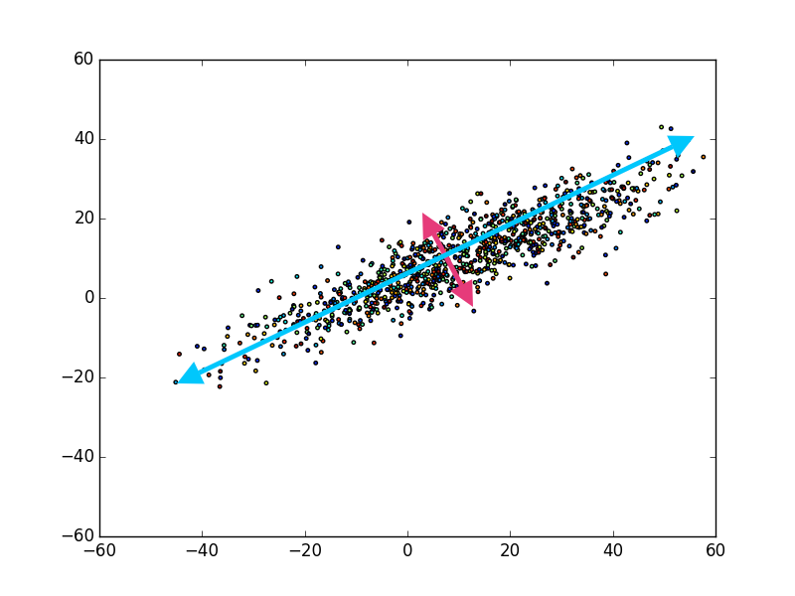
PCA: EXTRACTING TWO COMPONENTS

Slide 19
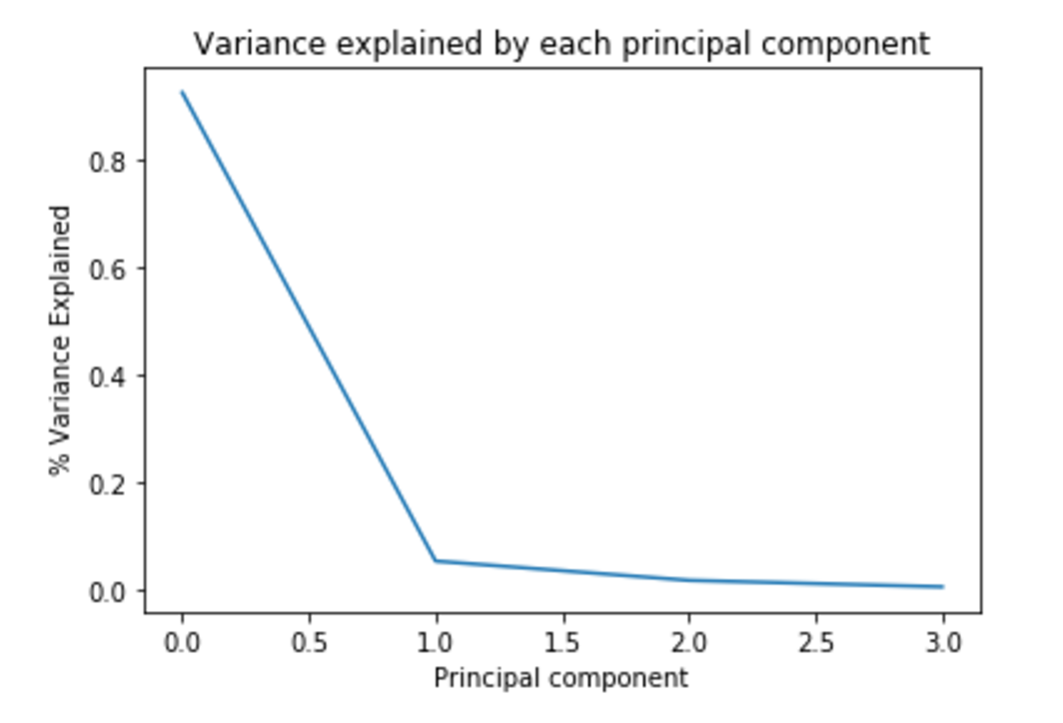
PCA: HOW MANY COMPONENTS?

Slide 20
DIMENSIONALITY REDUCTION IN TEXT REPRESENTATION
There are many techniques to do this automatically and most follow a very similar approach.
Identify correlated columns.
Replace them with a new column that encapsulates the others.
Doc # | Car | Truck | Van | Dog
6344 | 1 | 1 | 1 | 0
6345 | 0 | 1 | 1 | 1
6346 | 1 | 1 | 1 | 0
Doc # | Vehicle | Dog
6344 | 1 | 0
6345 | 1 | 1
6346 | 1 | 0

Slide 21

DIMENSIONALITY REDUCTION IN TEXT REPRESENTATION
PCA helps reduce the feature space into fewer dimensions.

Slide 22
LATENT VARIABLE MODELS
Latent variable models are models in which we assume the data we are observing has some hidden, underlying structure that we can’t see, and which we’d like to learn.
These hidden, underlying structures are the latent (i.e. hidden) variables we want our model to understand.
Text processing is a common application of latent variables.

Slide 23
LATENT VARIABLE MODELS
While language (in the classical sense) is defined by a set of pre-structured grammar rules and vocab, we often break those rules and create new words (e.g. selfie).
Instead of attempting to train our model on the rules of proper grammar, we’ll ignore grammar and seek to uncover alternate hidden structures.

Slide 24
LATENT VARIABLE MODELS
Latent variable techniques are often used for recommending news articles or mining large troves of data to find commonalities.
Topic modeling, a method we’ll cover today, is used in the NY times recommendation engine.
The New York Times attempts to map their articles to a latent space of topics using the content of the article.

Slide 25
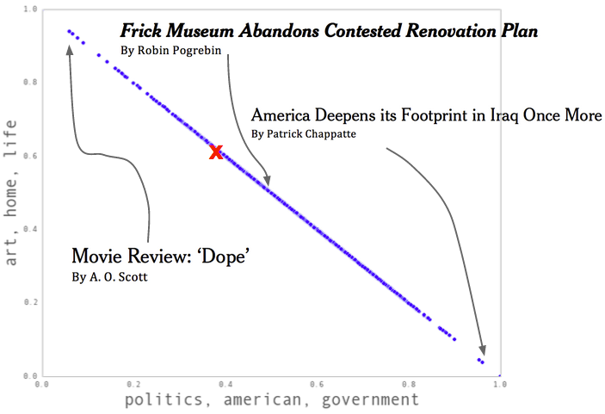
LATENT VARIABLE MODELS

Slide 26
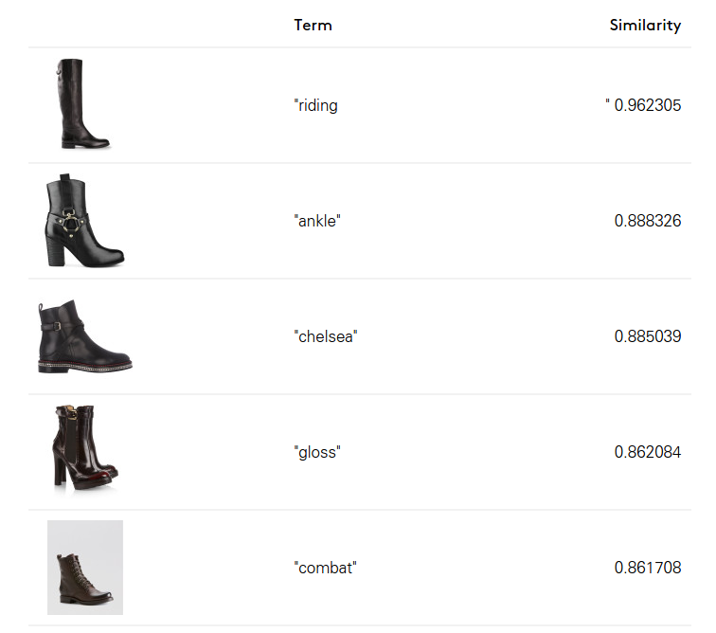
LATENT VARIABLE MODELS
Lyst, an online fashion retailer, uses latent representations of clothing descriptions to find similar clothing.

Slide 27
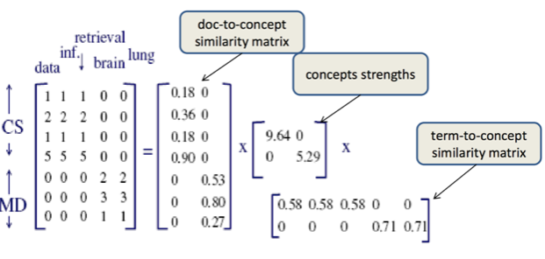
DIMENSIONALITY REDUCTION IN TEXT REPRESENTATION
Our previous ‘representation’ of a set of text documents (articles) for classification was a matrix with one row per document and one column per word (or n-gram).

Slide 28
DIMENSIONALITY REDUCTION IN TEXT REPRESENTATION
While this sums up most of the information, it does drop a few things, mostly structure and order.
Additionally, many of the columns may be correlated.

Slide 29
DIMENSIONALITY REDUCTION IN TEXT REPRESENTATION
For example, an article that contains the word ‘IPO’ is likely to contain the word ‘stock’ or ‘NASDAQ’.
Therefore, those columns are repetitive and likely to represent the same concept or idea.
For classification, we may only care that there are finance-related words.

Slide 30
DIMENSIONALITY REDUCTION IN TEXT REPRESENTATION
One way to deal with this is through regularization - L1/Lasso regularization tends to remove repetitive features by bringing their learned coefficients to 0.
Another is to perform dimensionality reduction ,where we first identify the correlated columns and the replace them with a column that represents the concept they have in common.
For instance, we could replace ‘IPO’, ‘stocks’, and ‘NASDAQ’ with a single column - ‘HasFinancialWords’ column.

Slide 31
DIMENSIONALITY REDUCTION IN TEXT REPRESENTATION
The techniques vary in how they define correlation and how much of the relationship between the original and new columns you need to save.
Dimensionality techniques can vary between linear and non-linear.

Slide 32
DIMENSIONALITY REDUCTION IN TEXT REPRESENTATION
There are many techniques build into scikit-learn.
One of the most common is Principal Component Analysis (PCA).
PCA, when applied to text data, is sometimes known as Latent Semantic Indexing (LSI).

Slide 33
DIMENSIONALITY REDUCTION IN TEXT REPRESENTATION
PCA helps reduce the feature space into fewer dimensions.

Slide 34
MIXTURE MODELS AND LANGUAGE PROCESSING
Mixture models (specifically LDA or Latent Dirichlet Allocation) take this concept further and generate more structure around the documents.
Instead of just replacing correlated columns, we create clusters of common words and generate probability distributions to explicitly state how related words are.

Slide 35
MIXTURE MODELS AND LANGUAGE PROCESSING
To understand this better, let’s imagine a new way to generate text:
Start writing a document
Choose a topic (sports, news, science).
Choose a random word from that topic.
Repeat.
Repeat for the next document.

Slide 36
MIXTURE MODELS AND LANGUAGE PROCESSING
This ‘model’ of text is assuming that each document is some mixture of topics.
It may be mostly science but may contain some business information.
The latent structure we want to uncover are the topics (or concepts) that generate that text.

Slide 37
MIXTURE MODELS AND LANGUAGE PROCESSING
Latent Dirichlet Allocation is a model that assumes this is the way text is generated and then attempts to learn two things:
The word distribution of each topic
The topic distribution of each document.

Slide 38
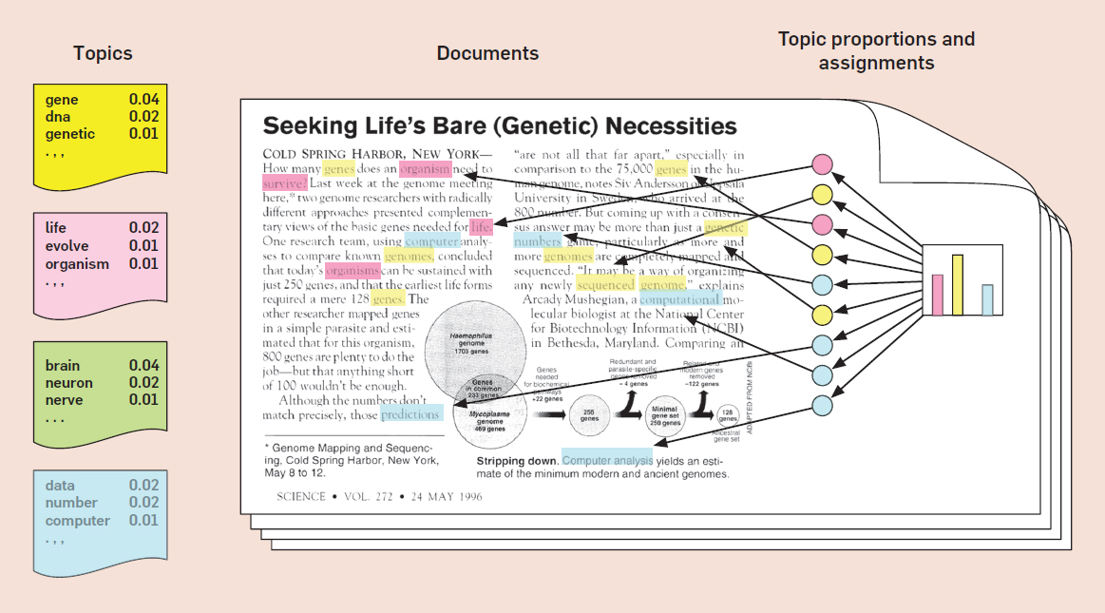
MIXTURE MODELS AND LANGUAGE PROCESSING

Slide 39
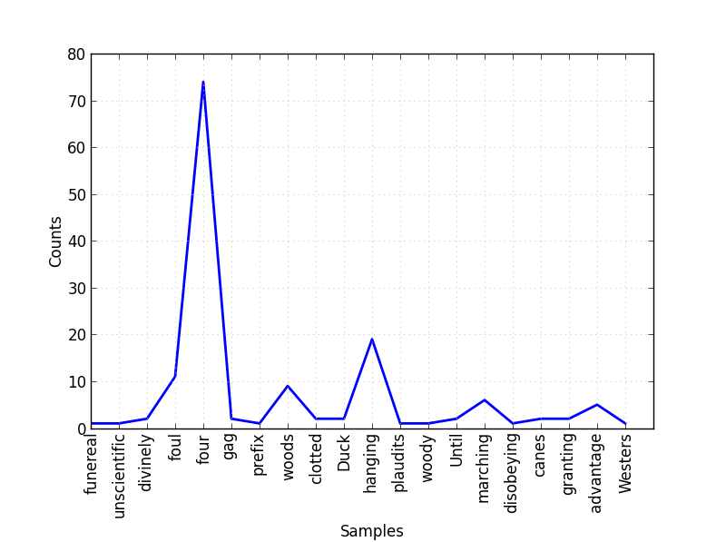
MIXTURE MODELS AND LANGUAGE PROCESSING
The word distribution is a multinomial distribution of each topic representing what words are most likely from that topic.

Slide 40
MIXTURE MODELS AND LANGUAGE PROCESSING
For example, let’s say we have three topics: sports, business, and science.
For each topic, we uncover the most likely words to come from them:
sports: [football: 0.3, basketball: 0.2, baseball: 0.2, touchdown: 0.02 ... genetics: 0.0001] science: [genetics: 0.2, drug: 0.2, ... baseball: 0.0001] business: [stocks: 0.1, ipo: 0.08, ... baseball: 0.0001]
For each word and topic pair, we learn some probability: P(word|topic).

Slide 41
MIXTURE MODELS AND LANGUAGE PROCESSING
The topic distribution is a multinomial distribution for each document representing what topics are most likely to appear in that document.
For all our of sample documents, we have a distribution over {sports, science, business}.
ESPN article: [sports: 0.8, business: 0.2, science: 0.0] Bloomberg article: [business: 0.7, science: 0.2, sports: 0.1]
For each topic and document pair, we learn some probability, P(topic|document).

Slide 42
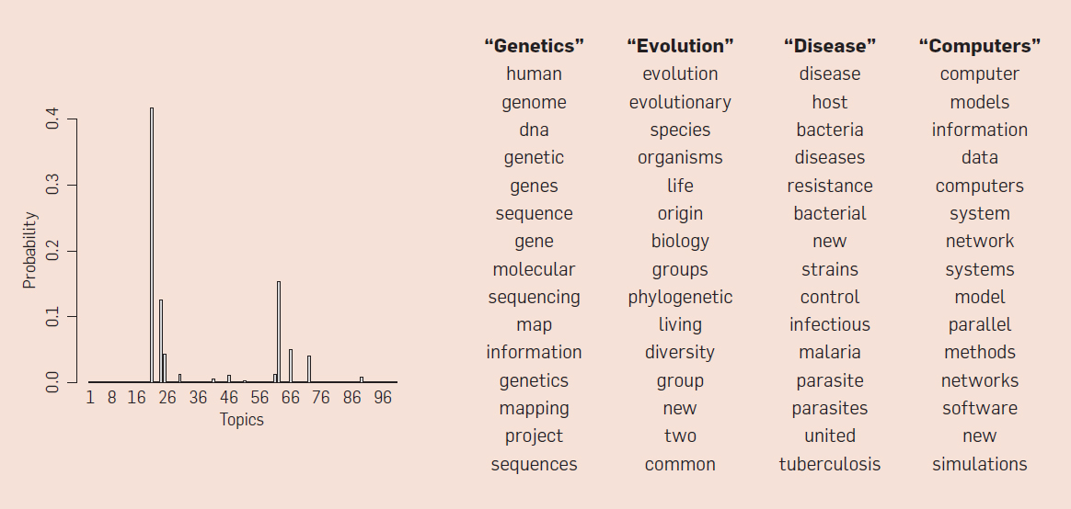
MIXTURE MODELS AND LANGUAGE PROCESSING

Slide 43
MIXTURE MODELS AND LANGUAGE PROCESSING
Topic models are useful for organizing a collection of documents and uncovering the main underlying concepts.
There are many variants that attempt to add even more structure to the ‘model’:
Supervised topic models guide the process with pre-decided topics.
Position-dependent topic models ignore which words occur in which document and instead focus on where they occur.
Variable number topic models test different numbers of topics to find the best model.

Slide 44

ACTIVITY: KNOWLEDGE CHECK
ANSWER THE FOLLOWING QUESTIONS
EXERCISE
Take any recent news article and brainstorm which three topics this story is most likely to be made up of.
Next, brainstorm which words are most likely derived from which of those three topics.
DELIVERABLE
Topics and word-topic pairs

Slide 45
DEMO
LDA IN GENSIM

Slide 46
LDA IN GENSIM
gensim is a library of language processing tools focused on latent variable models of text.
It was originally developed by grad students dissatisfied with current implementations of latent models.
Documentation and tutorials are available on the package’s website.

Slide 47
LDA IN GENSIM
Let’s first translate a set of documents (articles) into a matrix representation with a row per document and a column per feature (word or n-gram).

Slide 48
LDA IN GENSIM
from sklearn.feature_extraction.text import CountVectorizer cv = CountVectorizer(binary=False, stop_words='english', min_df=3) docs = cv.fit_transform(data.body.dropna()) # Build a mapping of numerical ID to word id2word = dict(enumerate(cv.get_feature_names()))

Slide 49
LDA IN GENSIM
We want to learn which columns are correlated (i.e. likely to come from the same topic).
This is the word distribution.
We can also determine what topics are in each document, the topic distribution.

Slide 50
LDA IN GENSIM
from gensim.models.ldamodel import LdaModel from gensim.matutils import Sparse2Corpus # First we convert our word-matrix into gensim's format corpus = Sparse2Corpus(docs, documents_columns = False) # Then we fit an LDA model lda_model = LdaModel(corpus=corpus, id2word=id2word, num_topics=15)

Slide 51
LDA IN GENSIM
In this model, we need to explicitly specify the number of topic we want the model to uncover.
This is a critical parameter, but there isn’t much guidance on how to choose it. Try to use domain expertise where possible.

Slide 52
LDA IN GENSIM
Now we need to assess the goodness of fit for our model.
Like other unsupervised learning techniques, our validation techniques are mostly about interpretation.
Use the following questions to guide you:
Did we learn reasonable topics?
Do the words that make up a topic make sense?
Is this topic helpful towards our goal?

Slide 53
LDA IN GENSIM
We can evaluate fit by viewing the top words in each topic.
gensim has a show_topics function for this:
num_topics = 25 num_words_per_topic = 5 for ti, topic in enumerate(lda.show_topics(num_topics = num_topics, num_words_per_topic = n_words_per_topic)): print("Topic: %d" % (ti)) print (topic) print()

Slide 54
LDA IN GENSIM
Some topics will be clearer than others. The following topics represent clear concepts:
0.009*cup + 0.009*recipe + 0.007*make + 0.007*food + 0.006*sugar
→ Cooking and Recipes
0.013*butter + 0.010*baking + 0.010*dough + 0.009*cup + 0.009*sugar
→ Cooking and recipes
0.013*fashion + 0.006*like + 0.006*dress + 0.005*style
→ Fashion and Style

Slide 55
ACTIVITY: KNOWLEDGE CHECK
ANSWER THE FOLLOWING QUESTIONS
EXERCISE
Demonstrate the code you used to generate the topics above.
Hypothesize other topic interpretations.
DELIVERABLE
Code and topics

Slide 56
INTRODUCTION
WORD2VEC

Slide 57
WORD2VEC
Word2Vec is another unsupervised model for latent variable NLP.
It was originally released by Google and further refined at Stanford.
This model creates word vectors, multidimensional representations of words.
assembly → [0.12315, 0.23425, 0.89745324, 0.235234, 0.234234, …]
This is similar to having a distribution of concepts or topics that the word may come from.

Slide 58
WORD2VEC
If we take our usual document-word matrix and take its transpose, instead of talking about words as being features of a document, we can talk about documents as being features of a specific word.
In other words, how do we define or characterize a single word?
We can do so by defining its dictionary definition.
Or we can enumerate all of the ways we might use it.

Slide 59
WORD2VEC
Given the word ‘Paris’, we have many contexts or uses we may find it in:
['_ is the capital of', '_, France', 'the capital city _', 'the restaurant in _',]
There are also a bunch of contexts we don’t expect to find it in:
['can I have a _', 'there's too much _ on this' ... and millions more]
We could make a feature or column for each of these contexts.
We could represent ‘Paris’ in a sparse feature with all possible contexts.

Slide 60
WORD2VEC
Additionally, the first few examples represent the same concept:
Paris is a city like thing, so it contains shops and restaurants.
Paris is a capital city.
We want to use dimensionality reduction to find a few concepts per word instead of all possible contexts.

Slide 61
WORD2VEC
With LDA, we could do this by identifying the topics a word was most likely to come from.
With Word2Vec, we will replace the overlapping contexts by some concept that represents them.
Like other techniques, our goal is to identify correlated columns and replace them with a new column that represents those replaced columns.
We can replace the [‘_ is a city’, ‘_ is a capital’, ‘I flew into _ today’] columns by a single column, ‘IsACity’.

Slide 62
WORD2VEC
With a trained model, Word2Vec can be used for many tasks.
A commonly used feature of Word2Vec is being able to ask what words are similar to each other.
For example, if you ask for words similar to ‘france’, you would get:
spain 0.678515 belgium 0.665923 netherlands 0.652428 italy 0.633130 switzerland 0.622323 luxembourg 0.610033 portugal 0.577154

Slide 63
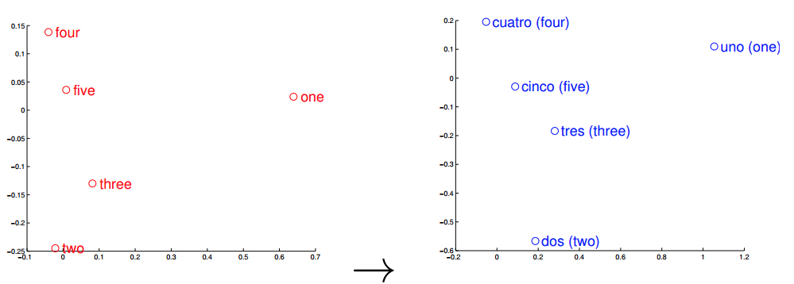
WORD2VEC
If we have data for other languages, Word2Vec could also be used for translation.

Slide 64
ACTIVITY: KNOWLEDGE CHECK
ANSWER THE FOLLOWING QUESTIONS
EXERCISE
After reviewing the analogies, brainstorm some word vector math. For example, what do you think would happen if you subtracted the vector for ‘Man’ from ‘King’. Do you think you would get ‘Queen’?
DELIVERABLE
Answers to the above questions

Slide 65
DEMO
WORD2VEC IN GENSIM

Slide 66
WORD2VEC IN GENSIM
We will build a Word2Vec model using the body text of the articles available in the StumbleUpon dataset.
from gensim.models.word2vec import Word2Vec
# Setup the body text text = data.body.dropna().map(lambda x: x.split()) from gensim.models import Word2Vec model = Word2Vec(text, size=100, window=5, min_count=5, workers=4)

Slide 67
WORD2VEC IN GENSIM
The Word2Vec class has many arguments.
size represents how many concepts or topics we should use.
window represents how many words surrounding a sentence we should use as our original feature.
min_count is the number of times that context or word must appear.
workers is the number of CPU cores to use to speed up model training.

Slide 68
WORD2VEC IN GENSIM
The model has a most_similar function that helps find the words most similar to the one you queried.
This will return words that are most often used in the same context:
model.most_similar(positive=['cookie', 'brownie'])
It can easily identify words related to those from this dataset.

Slide 69
HOMEWORK
TWITTER LAB

Slide 70
ACTIVITY: TWITTER LAB
DIRECTIONS (45 minutes)
EXERCISE
In this exercise, we will compare some of the classical NLP tools from the last class with these more modern latent variable techniques. We will do this by comparing information extraction on Twitter using two different methods.
NOTE: There is a pre-existing file of captured tweets you can use. It is located in the class repo for lesson-12. However, you can also collect your own tweets following the instructions in twitter-instructions.md.
DELIVERABLE
Working code and answers to the questions

Slide 71
ACTIVITY: TWITTER LAB
STARTER CODE
EXERCISE
Refer to the starter code provided in the class repository for lesson-14.
LOADING THE DATA
tweets = [tweet for tweet in open('../../assets/dataset/captured-tweets.txt', 'r')]
SETTING UP SPACY
from spacy.en import English nlp_toolkit = English()

Slide 72
ACTIVITY: TWITTER LAB
TASKS AND QUESTIONS
Use spacy to write a function to filter tweets down to those where Google is announcing a product. How might we do this? One way might be to identify verbs, where 'Google' is the noun and there is some action like 'announcing'
Write a function that can take a sentence parsed by spacy and identify if it mentions a company named 'Google'. Remember,spacy can find entities and code them as ORG if they are a company.
BONUS: Make this function work for any company.
Write a function that can take a sentence parsed by spacy and return the verbs of the sentence (preferably lemmatized).
For each tweet, parse it using spacy and print it out if the tweet has 'release' or 'announce' as a verb.
Write a function that identifies countries. HINT: the entity label for countries is GPE (or "GeoPolitical Entity").
Re-run (d) to find country tweets that discuss 'Iran' announcing or releasing.
EXERCISE

Slide 73
ACTIVITY: TWITTER LAB
TASKS AND QUESTIONS
EXERCISE
Build a word2vec model of the tweets we have collected using gensim.
First take the collection of tweets and tokenize them using spacy.
Think about how this should be done.
Should you only use upper-case or lower-case?
Should you remove punctuations or symbols?
Build a word2vec model.
Test the window size as well - this is how many surrounding words need to be used to model a word. What do you think is appropriate for Twitter?
Test your word2vec model with a few similarity functions.
Find words similar to 'Syria'.
Find words similar to 'war'.
Find words similar to "Iran".
Find words similar to 'Verizon'.
Adjust the choices in (b) and (c) as necessary.

Slide 74
ACTIVITY: TWITTER LAB
TASKS AND QUESTIONS
EXERCISE
Filter tweets to those that mention 'Iran' or similar entities and 'war' or similar entities.
Do this using just spacy.
Do this using word2vec similarity scores.
DELIVERABLE
Working code and answers to the questions

Slide 75
CONCLUSION
TOPIC REVIEW

Slide 76
CONCEPT REVIEW
Latent variable models attempt to uncover structure from text.
Dimensionality reduction is focused on replacing correlated columns.
Topic modeling (or LDA) uncovers the topics that are most common to each document and then the words most common to those topics.
Word2Vec builds a representation of a word from the way it was used originally.
Both techniques avoid learning grammar rules and instead rely on large datasets. They learn based on how the words are used, making them very flexible.

Slide 77
LESSON
EXIT TICKET
DON’T FORGET TO FILL OUT YOUR EXIT TICKET

